Slide 1


Maverick India Corporation
The Maverick Move
Commercial real estate · Franchising · Retail management · Ahmedabad, Gujarat

Slide 2
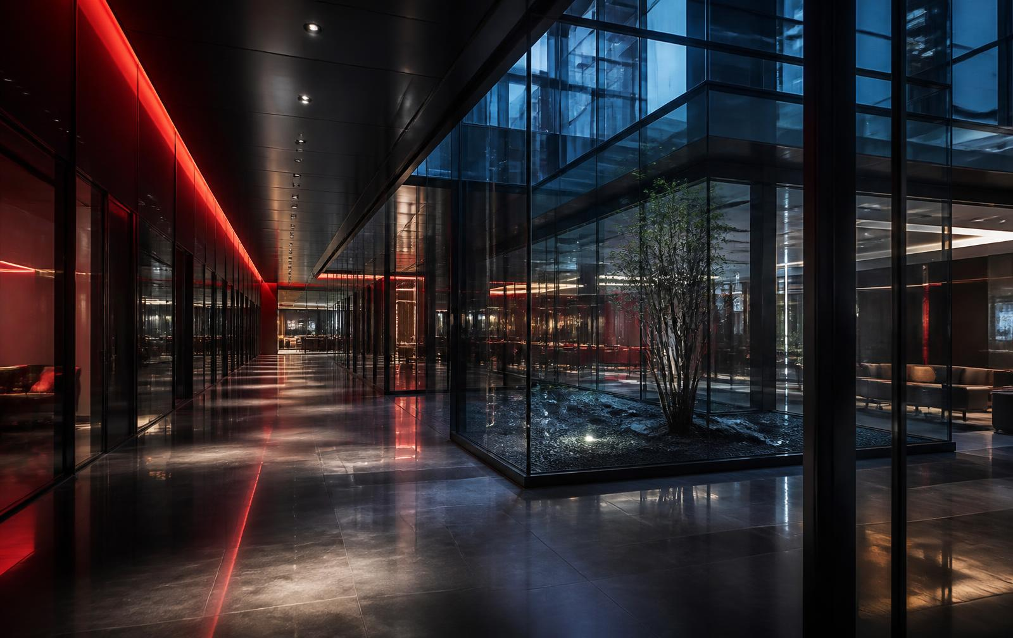
WHO WE ARE
One partner across property,
brands and retail
1
Property
Leasing, pre-leased assets, warehousing and land advisory across Gujarat and India.
2
Brands
Franchising and expansion strategy for brands and investors.
3
Retail
We open and operate stores on the ground, not just advise.

Slide 3
WHAT WE DO
Six services, one team
Commercial Leasing
Pre-Leased Properties
Warehousing & Industrial
Advisory and tailor-made leasing for corporates, institutions and MNCs.
Sourcing pre-leased assets for stable returns and exit appreciation.
1,000 sq. ft. to 5 lakh sq. ft. across Gujarat.
Land Consultancy
Franchising & Expansion
Buying, Selling & Investment
Parcel identification, negotiation, NA conversion and approvals.
Research-led city and location selection for brands and investors.
Transaction support across retail, IT, hospitality, healthcare and food.

Slide 4
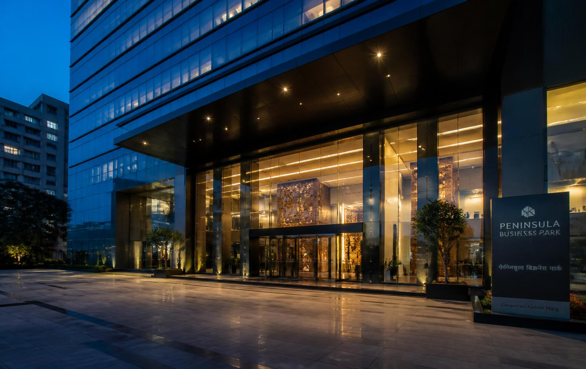
SERVICE 01
Commercial Leasing
Advisory and tailor-made leasing for corporates, institutions and MNCs.
Wide, verified property database
Direct relationships with building owners
Fit-out and handover coordination

Slide 5
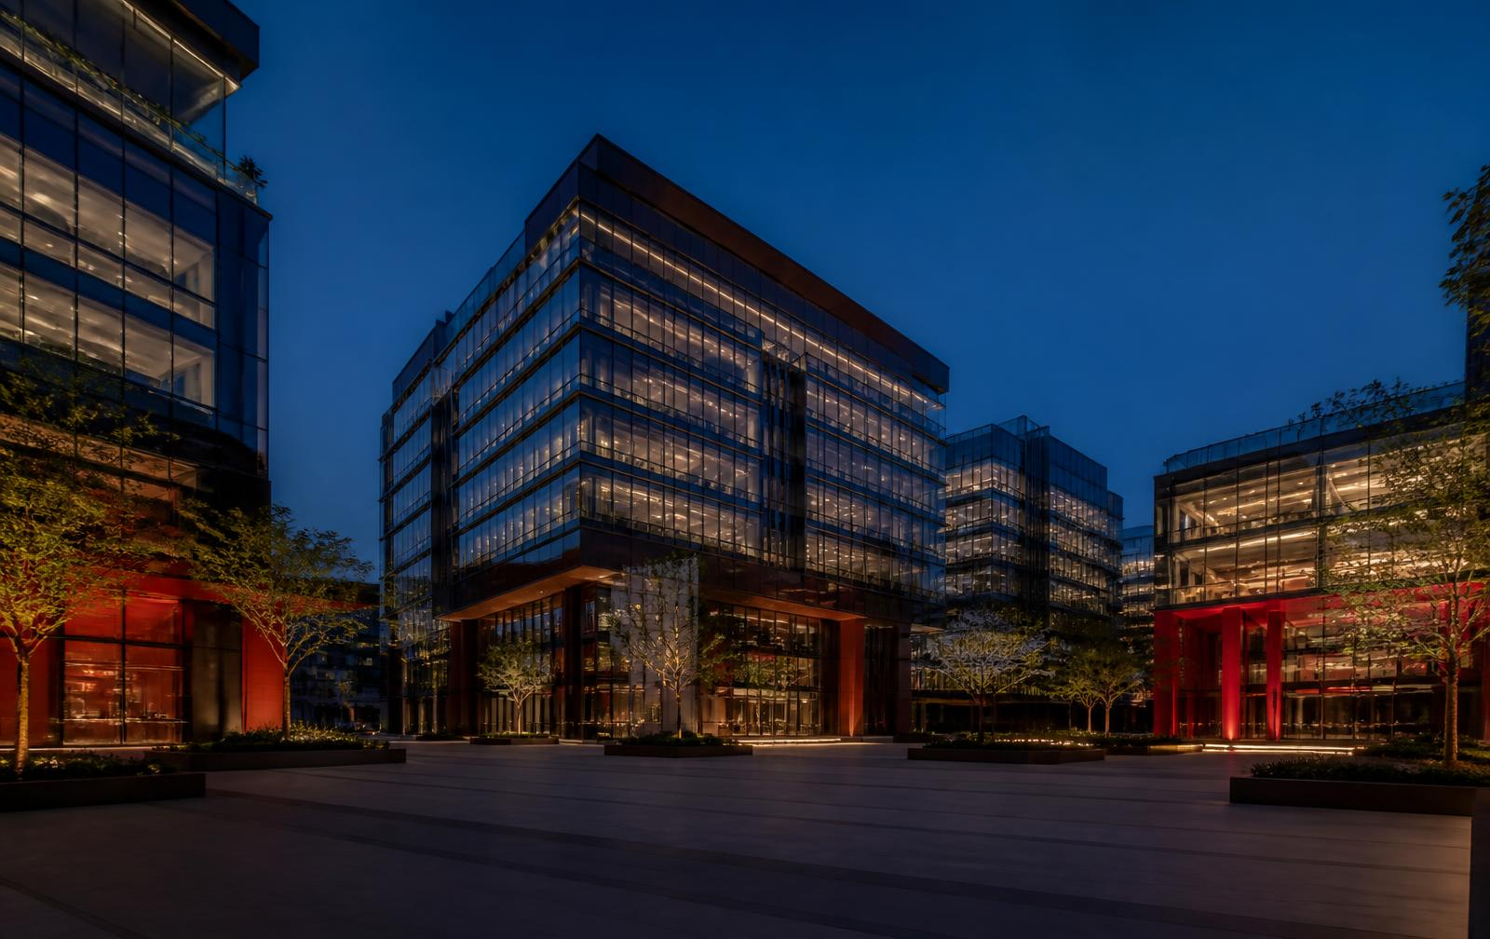
SERVICE 02
Pre-Leased Properties
Sourcing pre-leased assets for stable returns and exit appreciation.
Showrooms to large warehouses
Yield and exit appreciation worked through
Due diligence on tenant covenants

Slide 6

SERVICE 03
Warehousing & Industrial
1,000 sq. ft. to 5 lakh sq. ft. across Gujarat.
Warehouse, industrial and logistics space
Genuine industrial domain expertise
Coverage across Gujarat's key corridors

Slide 7
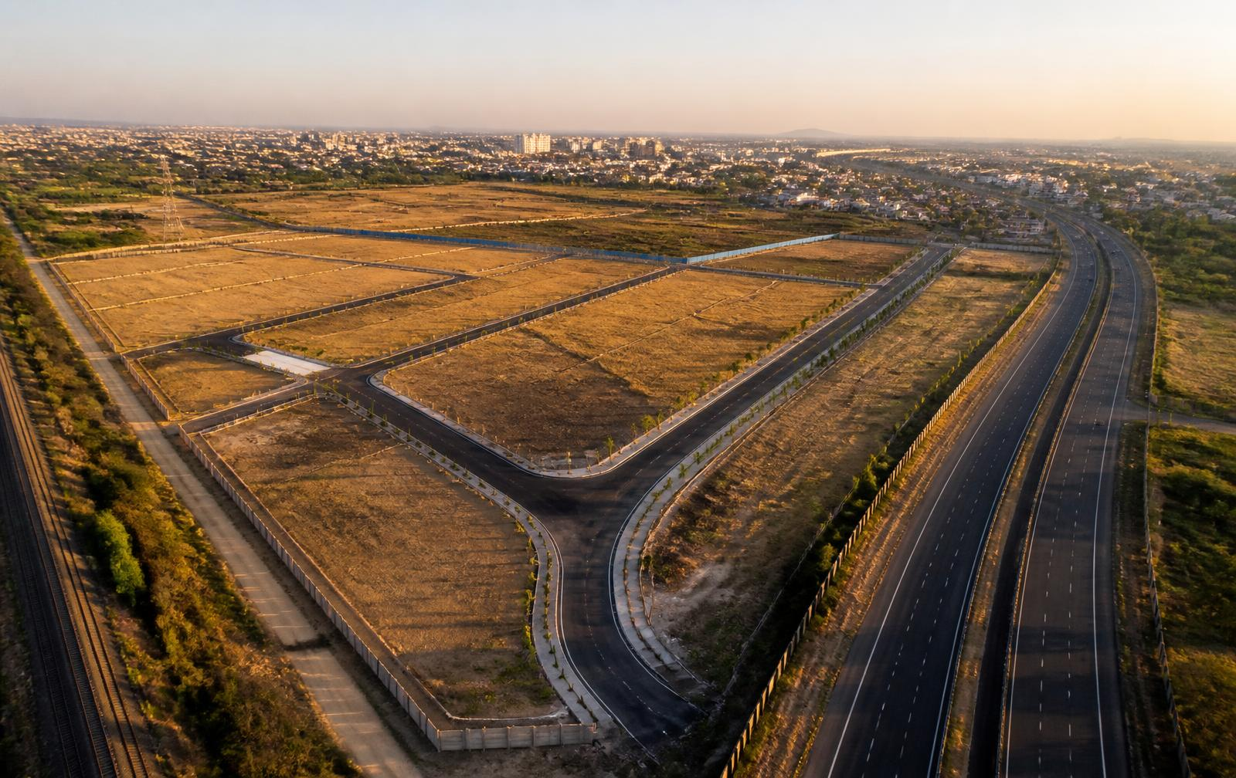
SERVICE 04
Land Consultancy
Parcel identification, negotiation, NA conversion and approvals.
Rate negotiation and title checks
NA conversion and zone identification
Industrial, commercial or residential use

Slide 8
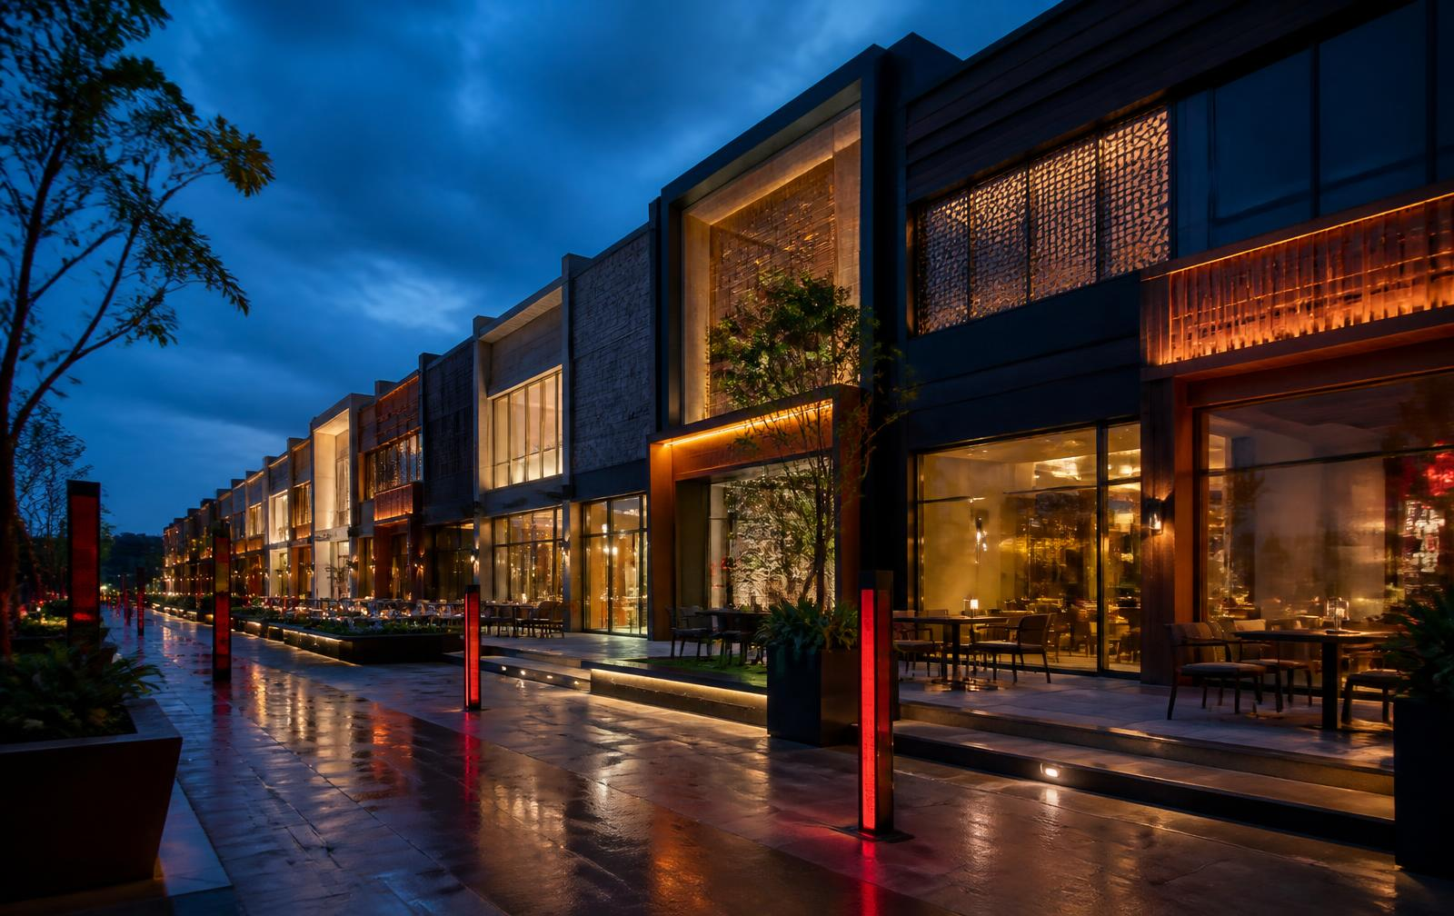
SERVICE 05
Franchising & Expansion
Research-led city and location selection for brands and investors.
Research-led city and location selection
Brand-to-investor matchmaking
Support through launch and beyond

Slide 9
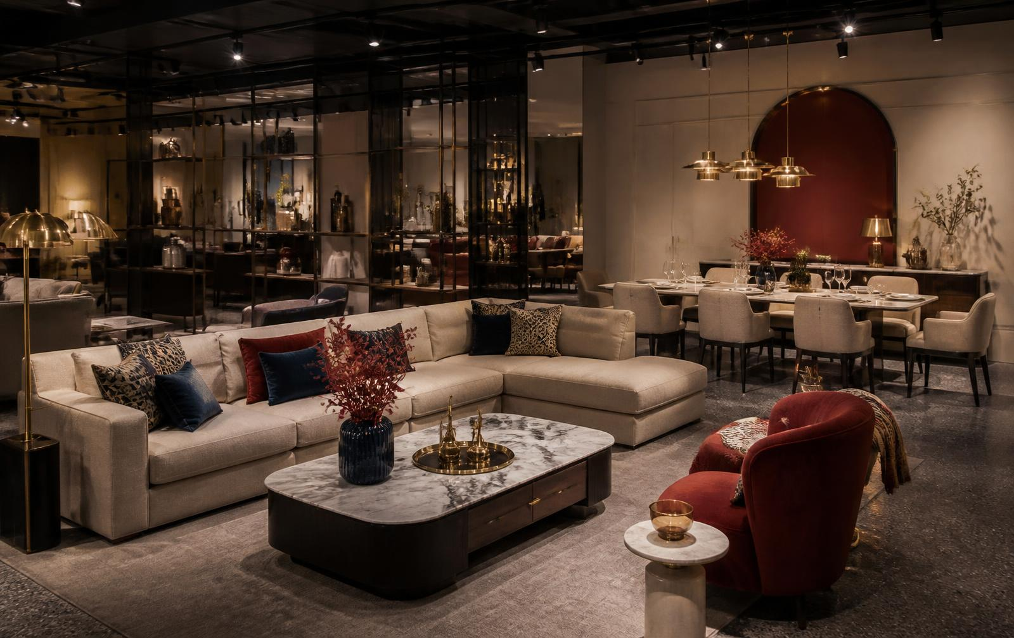
SERVICE 06
Buying, Selling & Investment
Transaction support across retail, IT, hospitality, healthcare and food.
Investors and developers, both sides
Retail, IT, hospitality, healthcare, food
Project and brand consulting alongside

Slide 10
OUR BRANDS
We don't just advise. We operate.
CAFE & HOSPITALITY
FURNITURE RETAIL
IN THE PIPELINE
Gulabo & Co.
Royal Oak Furniture
Next brand
Our own cafe at Vijay Cross Road, Navrangpura, Ahmedabad.
Retail management partner — two stores opening in Gujarat.
Sourcing and building the next brand partnership.

Slide 11
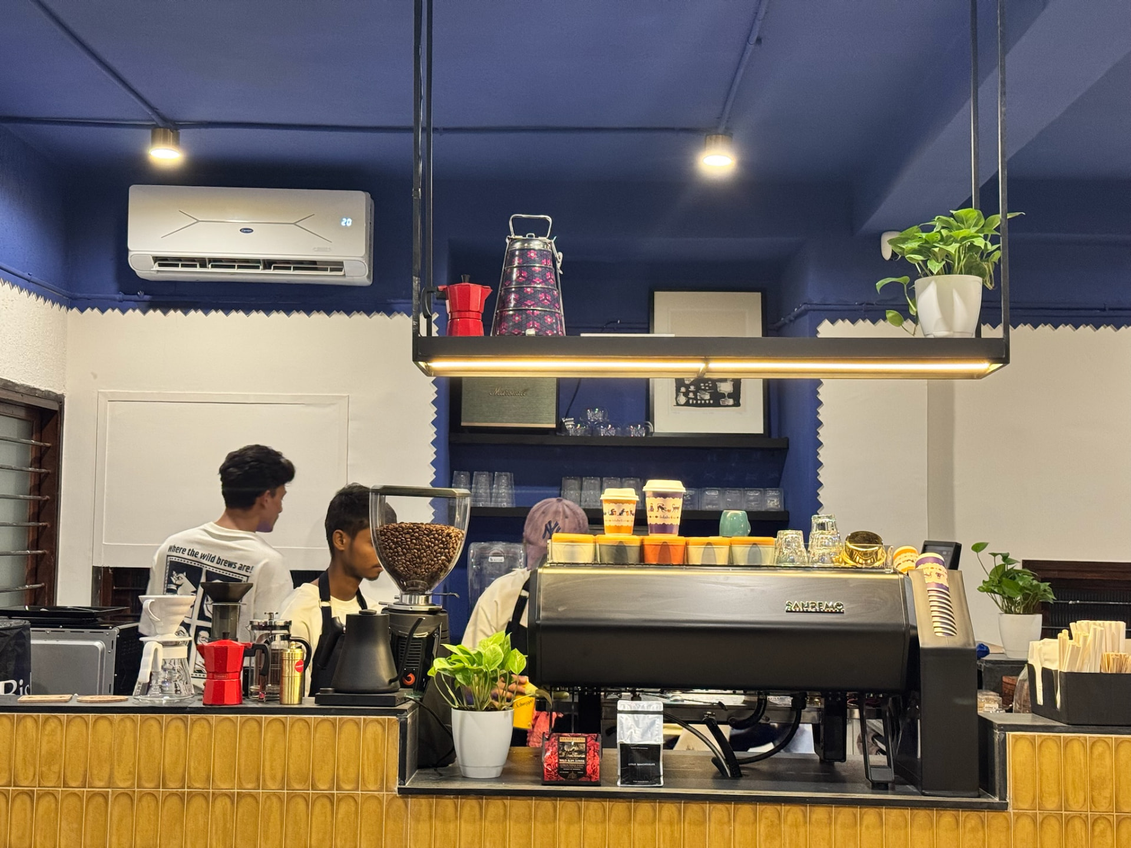
BRAND 01
Gulabo & Co.
A warm, vibrant cafe built for conversations, comfort and good food — soulful flavours and handcrafted beverages.
LOCATION
Vijay Cross Rd, Navrangpura, Ahmedabad 380009
HOURS
Monday – Sunday, 11:00 AM – 11:30 PM
ORDER
Zomato and Swiggy · +91 99746 36599

Slide 12
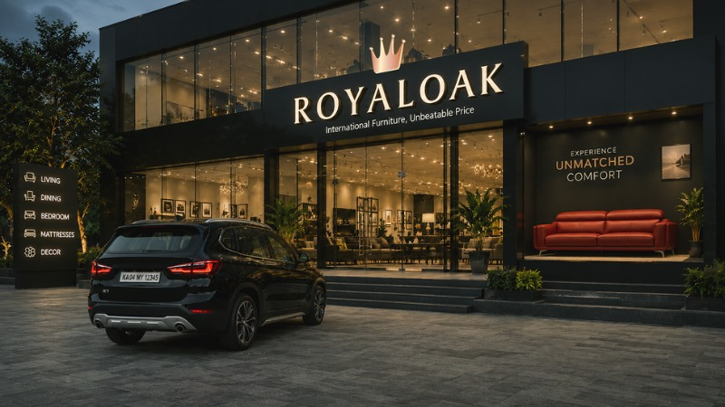
BRAND 02
Royal Oak Furniture
One of India's largest furniture retail brands. Maverick India Corporation is the retail management partner — opening and operating two upcoming stores in Gujarat.
Surat, Gujarat
COMING SOON
Vadodara, Gujarat
COMING SOON

Slide 13
LET'S TALK
Start the Maverick Move
PHONE / WHATSAPP
EMAIL
+91 85111 33003
maitrick.maverickcorp@gmail.com
FRANCHISING
OFFICE
franchising@themaverickindia.com
Mondeal Heights, B Wing, 17th Floor,
S.G Highway, Ahmedabad 380015

